Slide 1
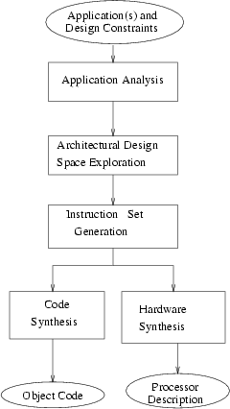
Flow Diagram of ASIP Design Methodology

Slide 2
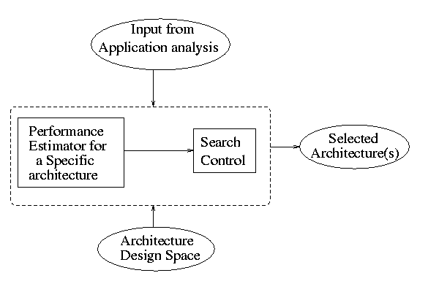
Architectural Design Space Exploration
A set of of possible architectures identified. Performance is estimated
to select suitable architecture satisfying input constraints and having
minimum hardware.
Block diagram of an architectural explorer
Parameterized architecture model is used

Slide 3
Instruction Set Generation
Instruction set is generated through synthesis or a selection process
Instruction Synthesis based on application requirements quantified
in terms of required micro-operations and their frequencies
Huang et al integrated instruction synthesis with scheduling problem
Instruction Selection A superset of instructions is available and
subset is selected to satisfy performance requirements within the
architectural constraints.
Most approaches use pattern matching for instruction selection.
The set of template pattern is extracted from the instruction set
and the graph representing intermediate code of the application
is covered by these patterns. By arranging instruction patterns
in a tree structure, matching becomes significantly fast.

Slide 4
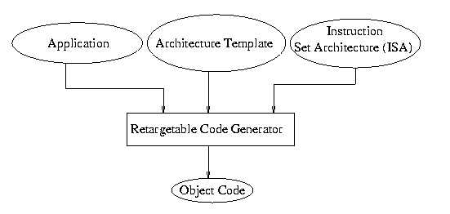
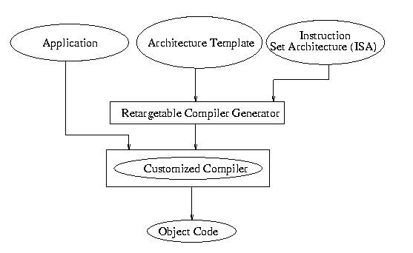
Code Synthesis
Code is synthesized in two ways
- Using a retargetable code generator
- Using a customized compiler generated by
compiler generator for a specific architecture
Block diagram of a
retargetable code generator
Block diagram of a
compiler generator

